Slide 1
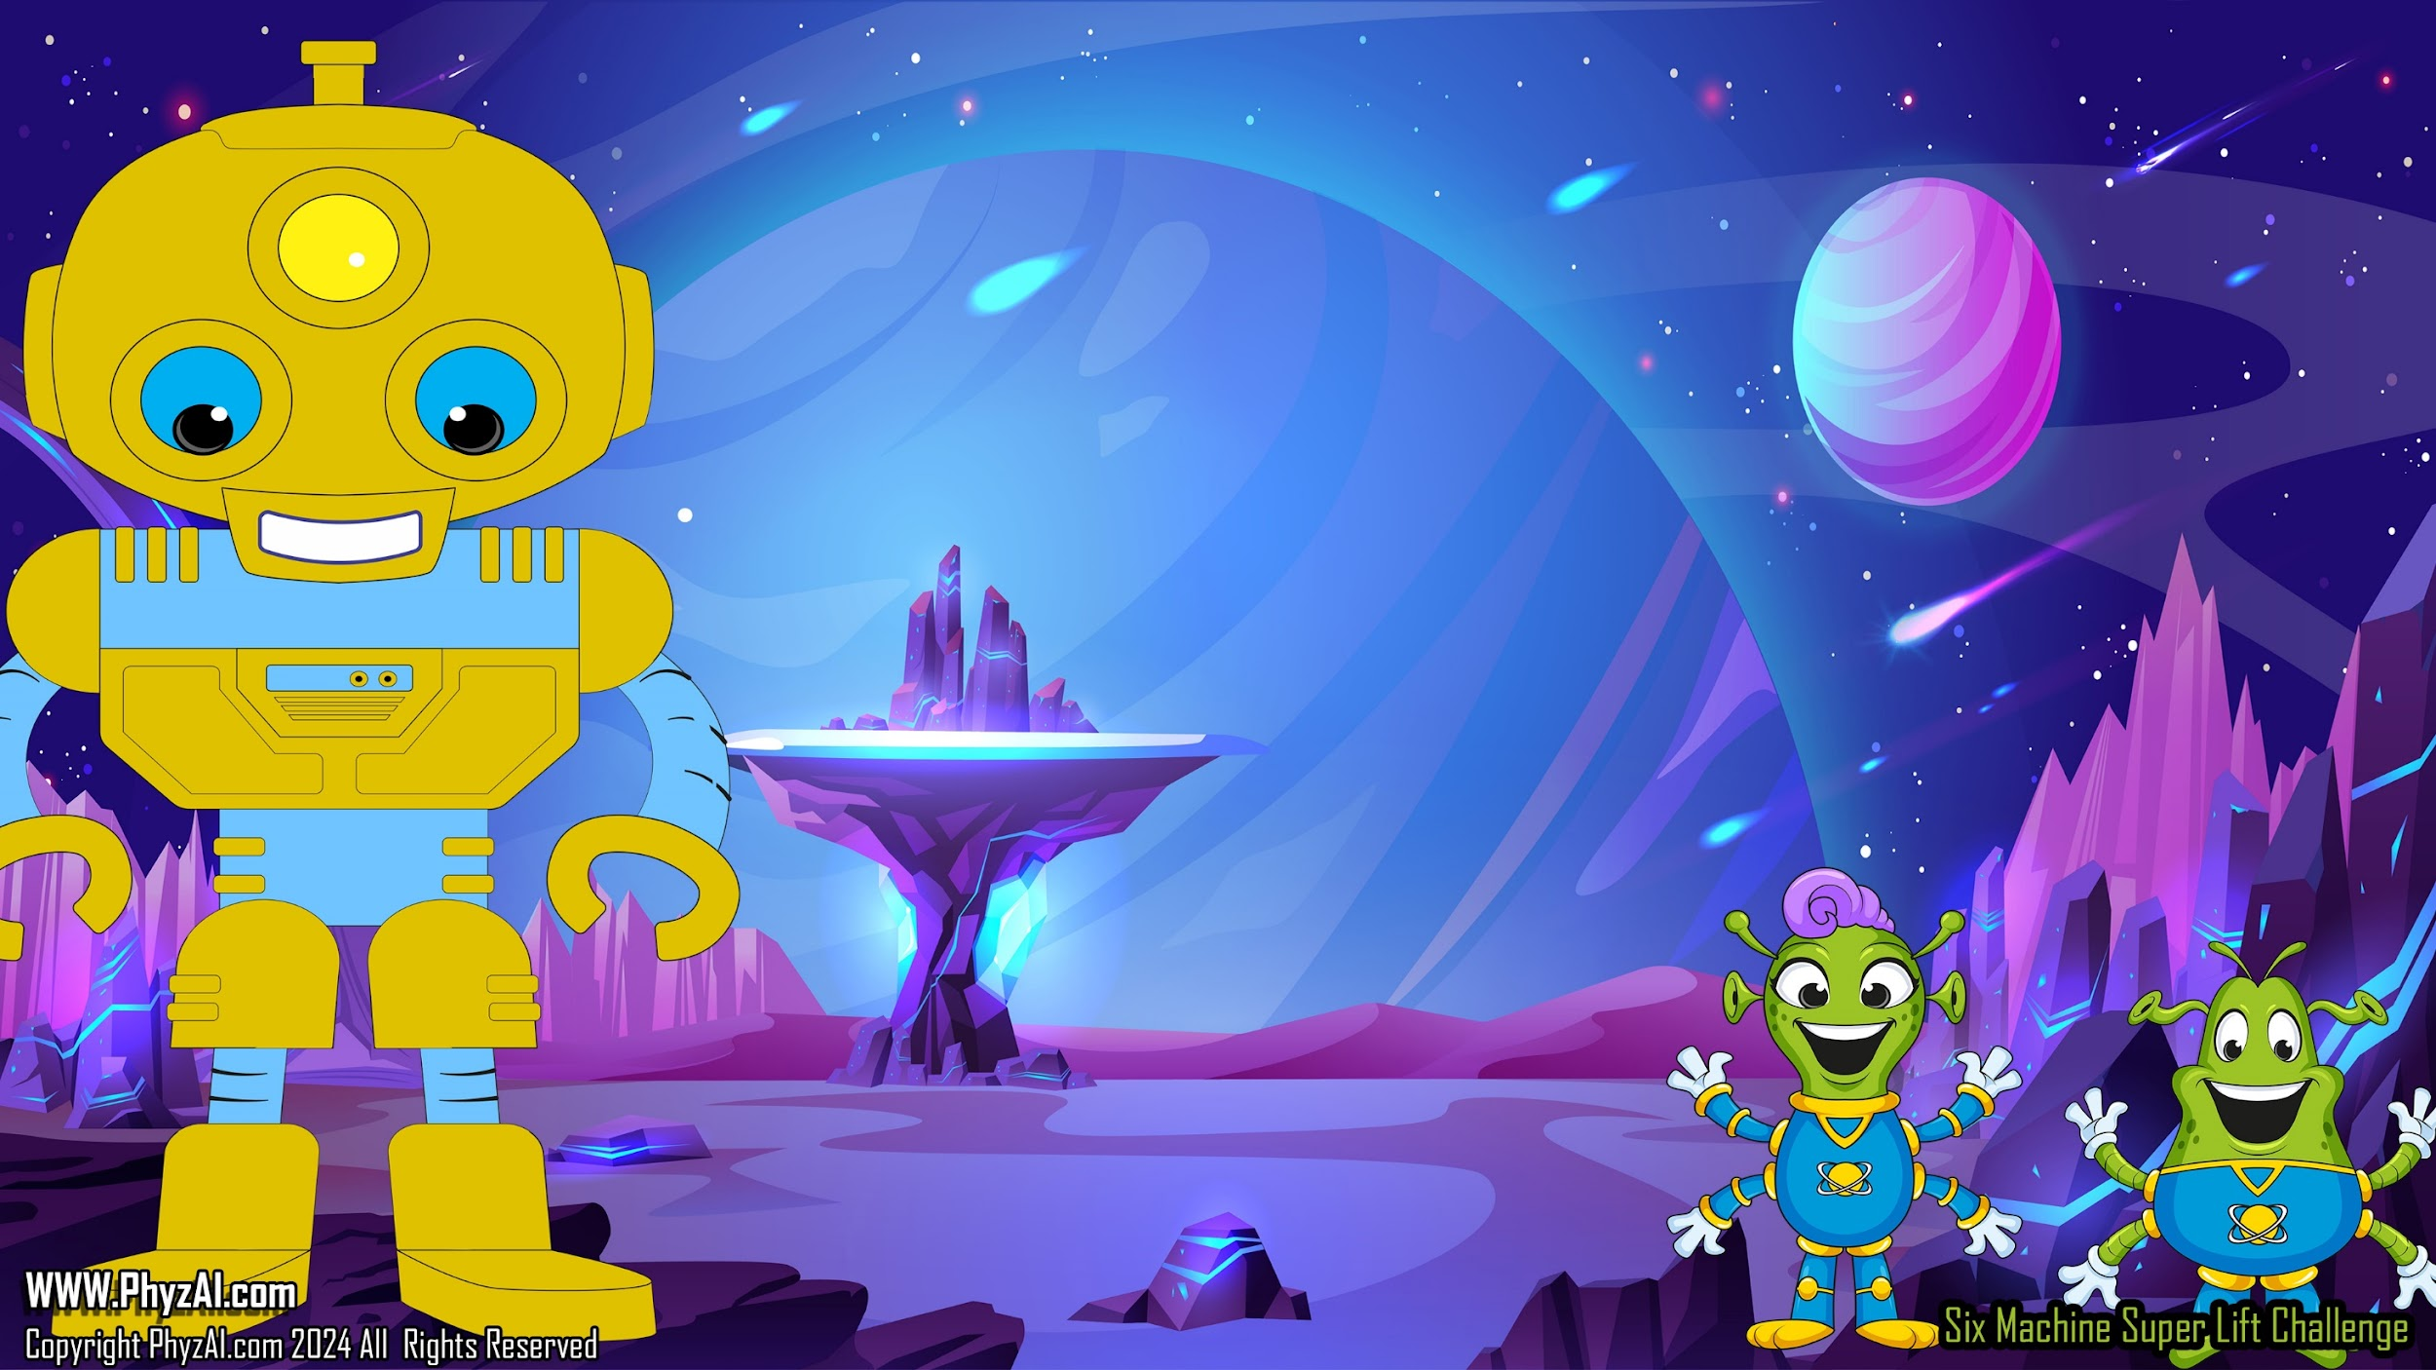
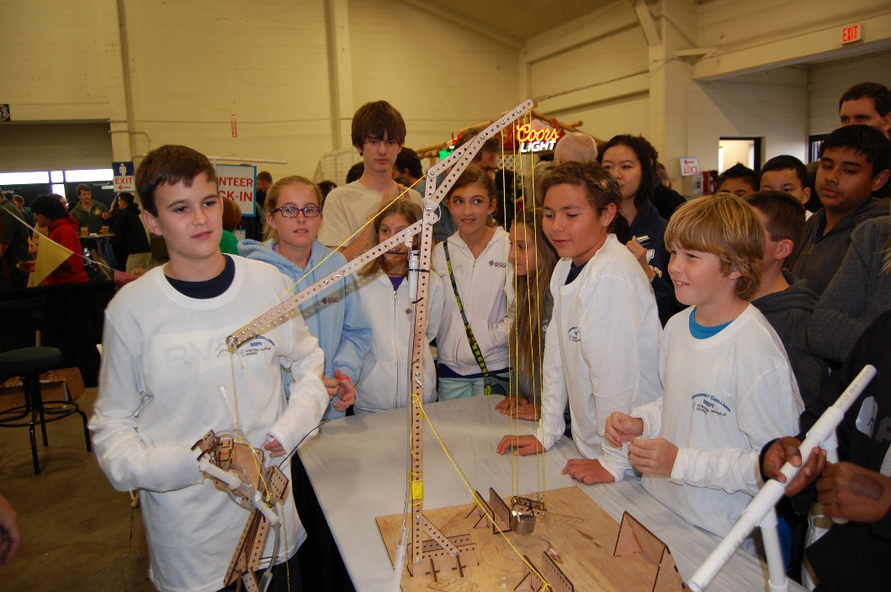
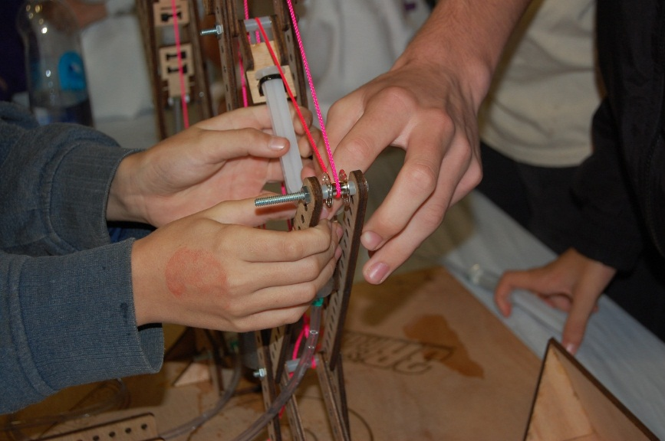
PULLEYS
Six simple mechanical machines in the Hydro-Bot Challenge
Notes:
In the next series of slides, we're going to take a look at pulleys, another one of the six simple machines outlined in our program.
____
As we venture further into our cosmic curriculum, we'll be setting our sights on **pulleys** – yet another ingenious invention from the compendium of six simple machines. These clever devices are not just a loop in space; they're the key to lifting and moving objects with ease across the universe!

Slide 2

Six Simple Machines
Wh
E
E
L
Load
Effort
Effort
Effort
LEVER
Axel
FULCRUM
Load
Load
Effort
Load
Wedge
Effort
Effort
Load
Load
Load

Slide 3

Pulley
Pulleys are very good at
converting effort to lift
and are very effective at
giving us the ability to
control the position
of our load.
Effort
Load
Notes:
The pulley, like the other six simple machines listed here can change the direction of the effort force or increase the effort force depending on whether the pulley is fixed or removable.
____
The pulley, a star player among the six simple machines, has the cosmic ability to **redirect the effort force** or **amplify it**, all hinging on its status as either a steadfast fixture or a movable marvel.

Slide 4

A single pulley system will not change the amount of force needed to move a load but it is very effective in allowing us to alter
the direction of motion.
Pulling down on a string can lift a load up.
This can be very useful in when we need to work within a confined area.
100%
Effort
100% Load
Notes:
Fixed pulleys do not offer much in the way of mechanical advantage. However, it gives us an opportunity to change the direction of an effort force.

Slide 5

A pulley is often called a block and tackle.
The pulley or wheels are
called Blocks and rope or
string is called the Tackle.
The wheels in pulleys are sometimes called Sheaves
or Drums.
100%
Effort
100% Load
Notes:
A pulley is often called a block and tackle. The pulley or wheels are called Blocks and rope or string is called the Tackle. The wheels in pulleys are sometimes called Sheaves or Drums.

Slide 6
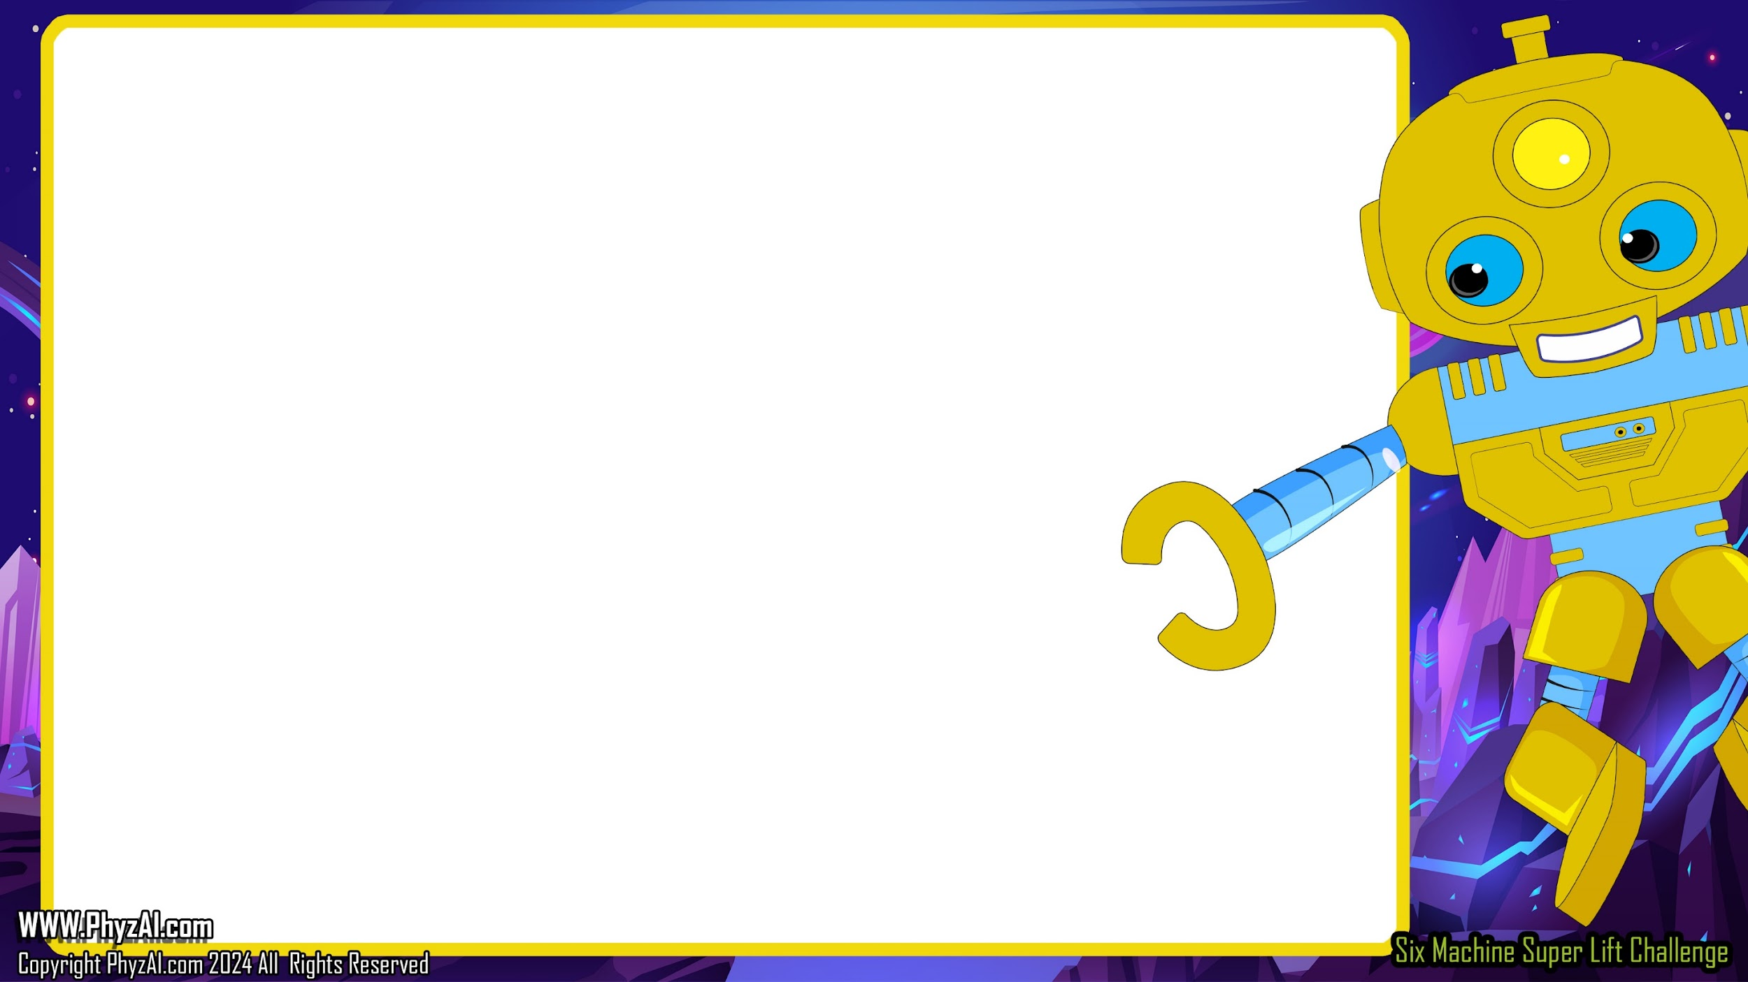
The power of the pulley starts to be seen when we combine two or more sheaves together.
By adding one more pulley to our system, we effectively ½ the amount of effort needed to move our load.
A simple pulley with two wheels is called a Gun Tackle as it was used to load cannons on old warships.
50%
Effort
100% Load
Notes:
In this particular pulley configuration, the effort force is magnified and the effort direction is the same direction as the load.

Slide 7
The more sheaves
we combine, the more effective our lifting system becomes.
Each wheel effectively
reduces the amount of
effort needed to lift by half.
33.3%
Effort
100% Load
Notes:
As we add multiple pulleys to the system, we notice that the amount of effort force required to lift a load is significantly reduced. We also noticed that the direction in which the effort force is being applied is opposite to the direction that the load travels.

Slide 8

A system with four pulley wheels requires only ¼ of the load in effort to lift or move.
25%
Effort
100% Load
Notes:
You may have started to notice a pattern here that as the number of pulleys increase, the amount of effort decreases proportionally. So, the more pulleys you have in the system the less effort is required to move the load.

Slide 9

100% Load
14.5% effort
And this continues as you add more sheaves into the system. With 8 wheels, you only need 14% of the load in effort.
Notes:
Now, we know that the more pulleys we have, the less effort is needed to lift the load but what you've also probably is that it takes a lot more strain to move the load the same height. So the more pulleys you have, the more string you have, and the longer you have to pull on the string to lift the load to the predetermined height.

Slide 10

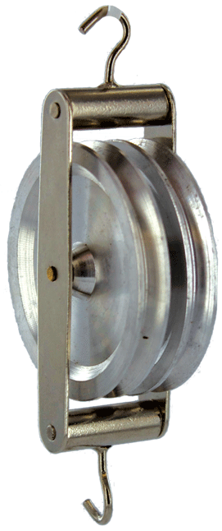
Sheaves can be combined into groups.
33.3%
Effort
These units are called blocks and each block can contain any number of sheaves.
100% Load
Notes:
Sheaves can be combined into groups. These units are called blocks and each block can contain any number of sheaves.

Slide 11

But there is a price to pay for all of this lifting power.
Each sheave also doubles the distance we must pull the
tackle in order to have an effect on the load.
25%
Effort
100% Load
25% movement
100% Pull
Notes:
Here, you see a great graphic that clearly illustrates the concept of how the more pulleys you have, the more string you have, and the greater distance you must pull in order to lift the load to a predetermined height. However, this is a fair trade off because it requires a lot less effort to move the load giving you tremendous mechanical advantage.
____
Behold, a stellar illustration that unveils the secret of pulleys: the more you have in your cosmic toolkit, the longer the string and the farther you'll need to pull to elevate your load to the desired altitude. But fear not, for this exchange is well worth it! Less effort is needed to move your celestial cargo, granting you an astronomical mechanical advantage.

Slide 12

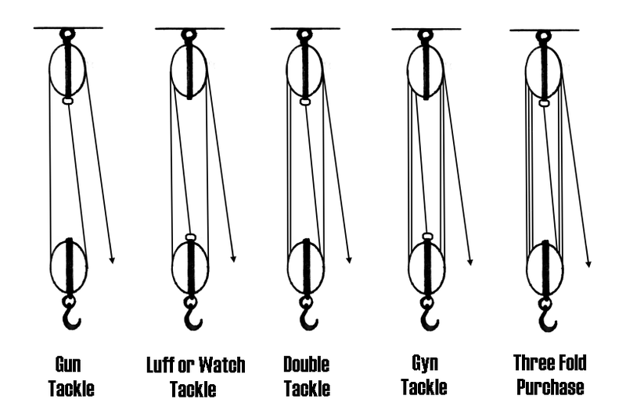
There are specific names for pulleys with different numbers of sheaves.
2 3 4 5 6
Notes:
Now, depending on your needs, the pulleys can be configured in a multitude of different ways. Here are some popular ways in which pulley configurations have allowed users to gain mechanical advantage.

Slide 13


In some cases we can combine the work of two or more pulleys.
The illustration here may not
increase the life effectiveness of
the system but it does give
us perfect control for placement.
Pulling one side more then
the other moves the load
left or right as we lift.
50-100%
Effort
50-100%
Effort
Notes:
Of course, not every pulley combination gives us mechanical advantage. In this particular illustration, this pulley configuration gives us tremendous control over the horizontal movement of the load. This is great because in our Super-Lift Challenge, we need to be able to keep the load within the perimeter etched into the platform.

Slide 14
Sometimes we don’t need the pulley to lift the load at all but only to keep in position.
75-150%
Effort
When using theses types of systems, we need to be very carful that we are not pulling against the lift of the opposing pulley. If we do, we can make our lift have more load on it than it should.
0-100%
Effort
Notes:
As mentioned before, pulleys don't always give us mechanical advantage but gives us the opportunity to control the position of the load. In this illustration, it gives us the opportunity to move the load from one position into another horizontal position.

Slide 15

Not all pulleys have to lift.
Sometimes we use a pulley to put added effort on a line, to keep up the tension, add some pressure to the line, or even to add some additional amount of lift.
Notes:
At other times, pulleys give us an effective way to keep tension on lines so that we are getting the most effective pull on the load that we can.

Slide 16
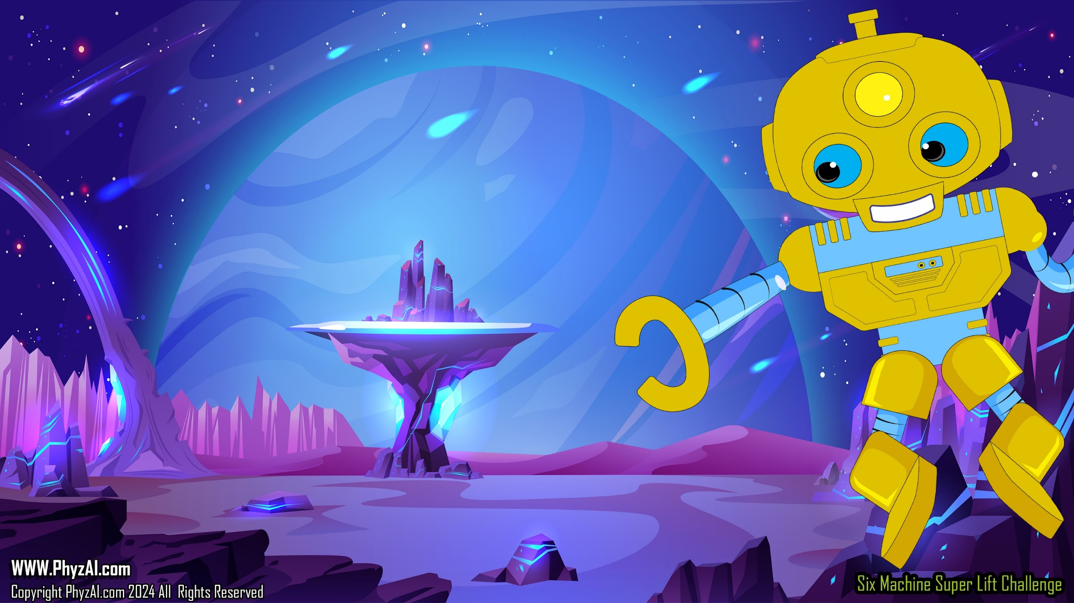
Looking at these entries from other schools can you tell how they used string and pulleys to give them mechanical advantage and control in their lift attempts?
Notes:
In the following pictures, see if you can identify effective uses of pulley systems that give the users mechanical advantage in lifting their loads.

Slide 17

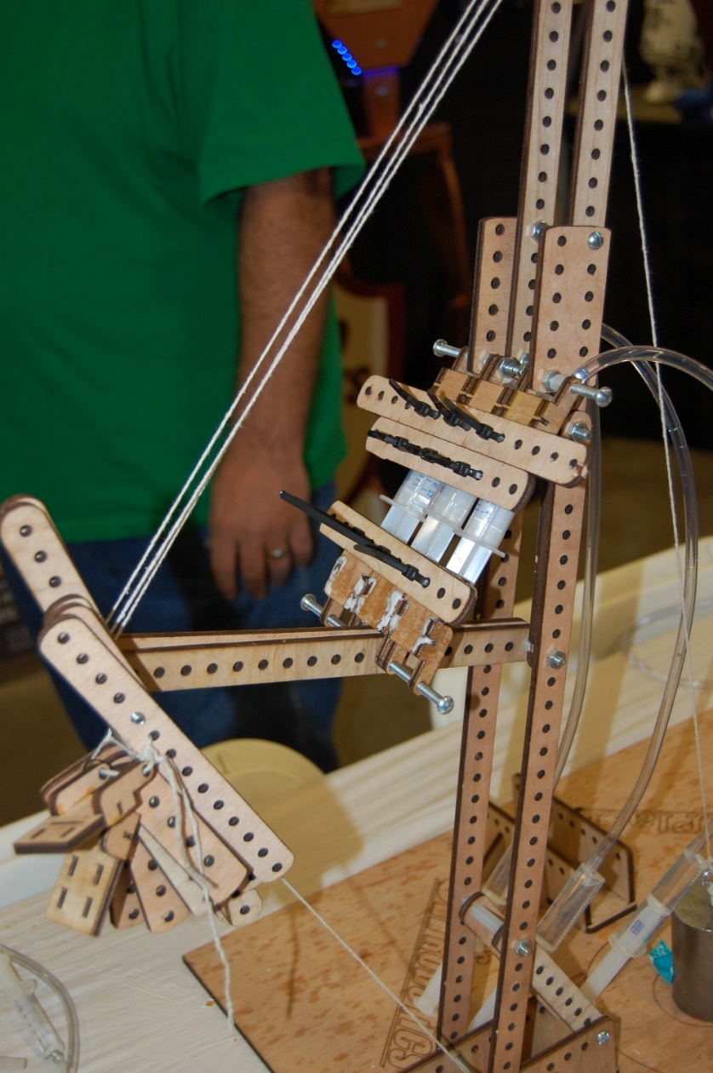
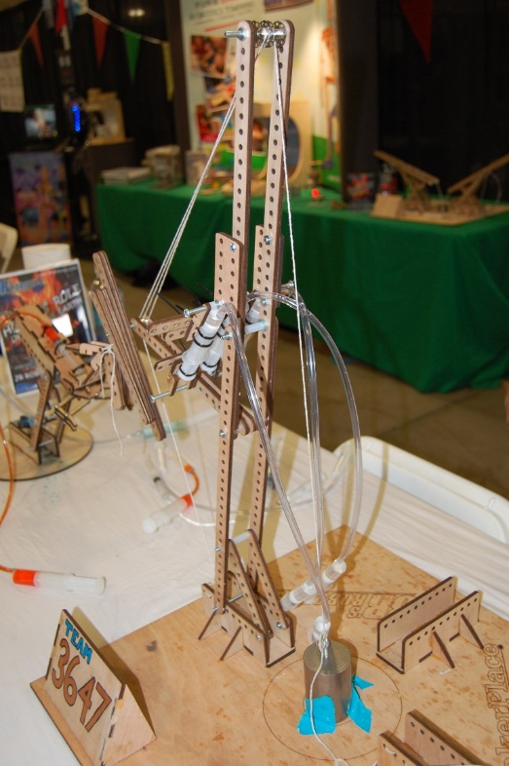
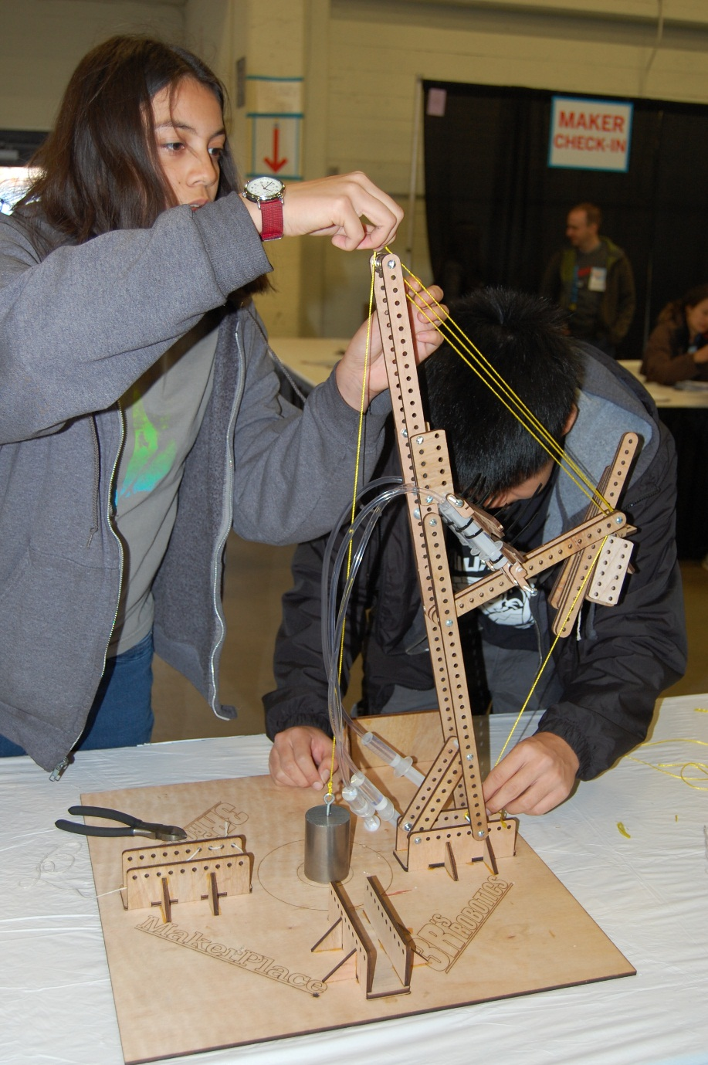
Use of kit components as a
counterweight is no longer allowed

Slide 18

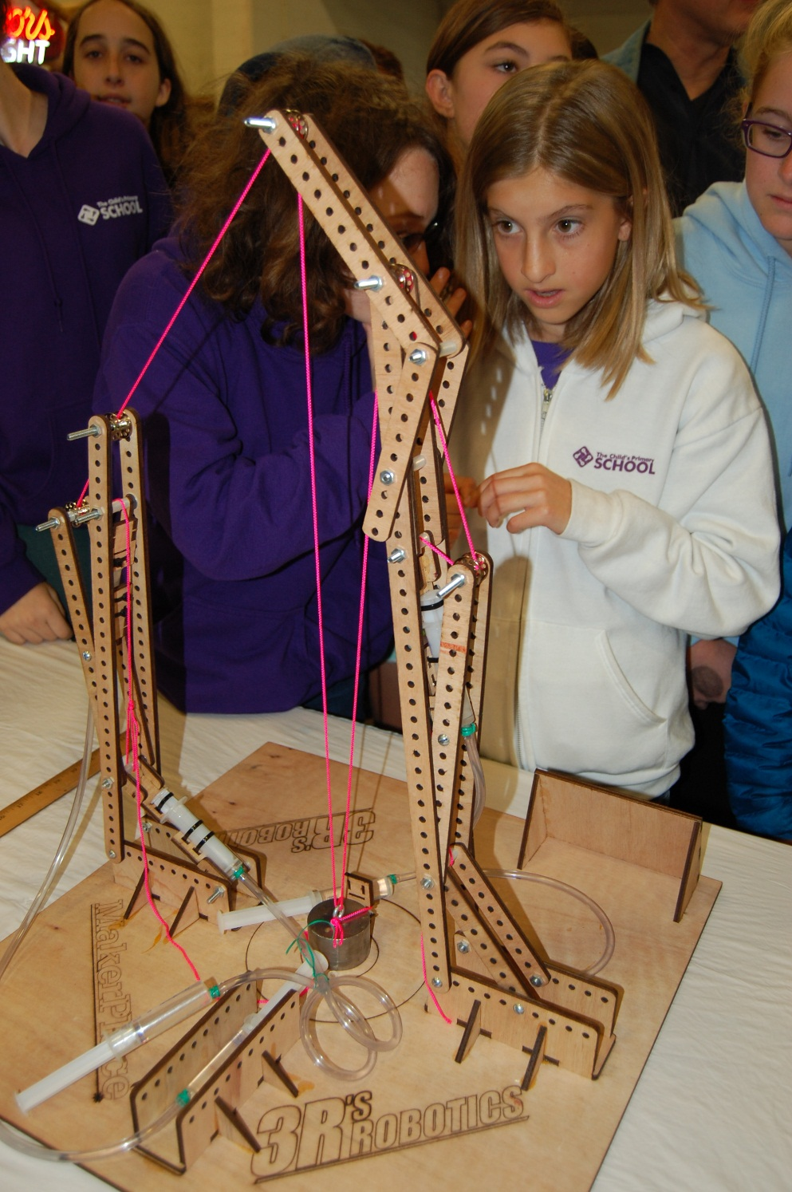
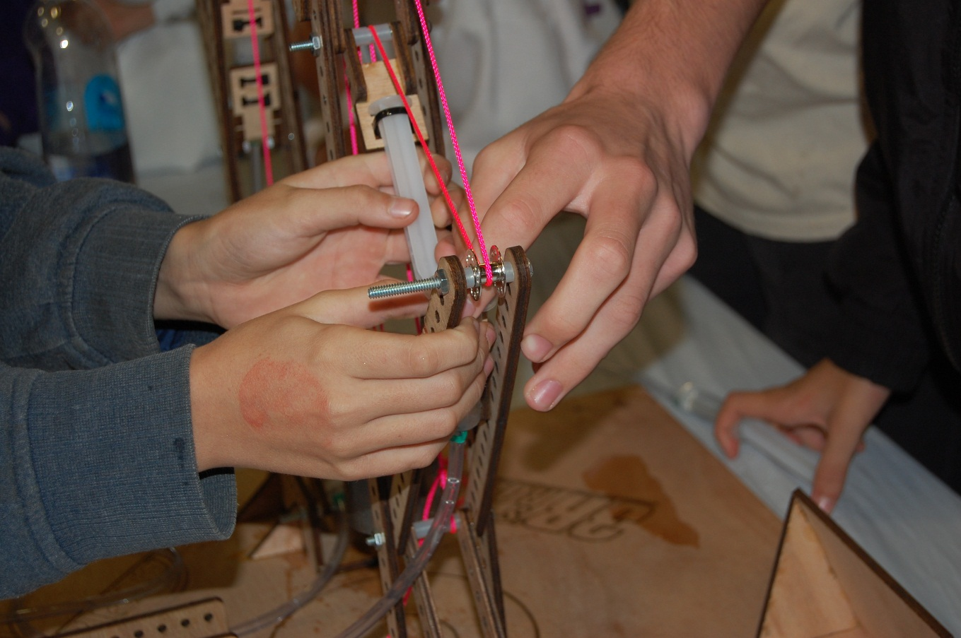
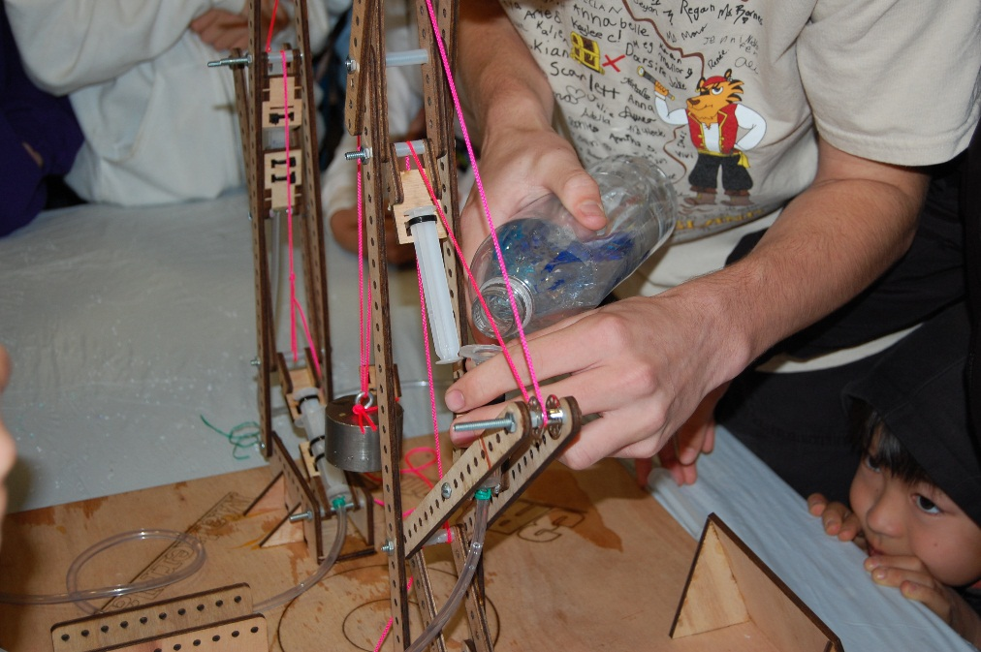

Slide 19

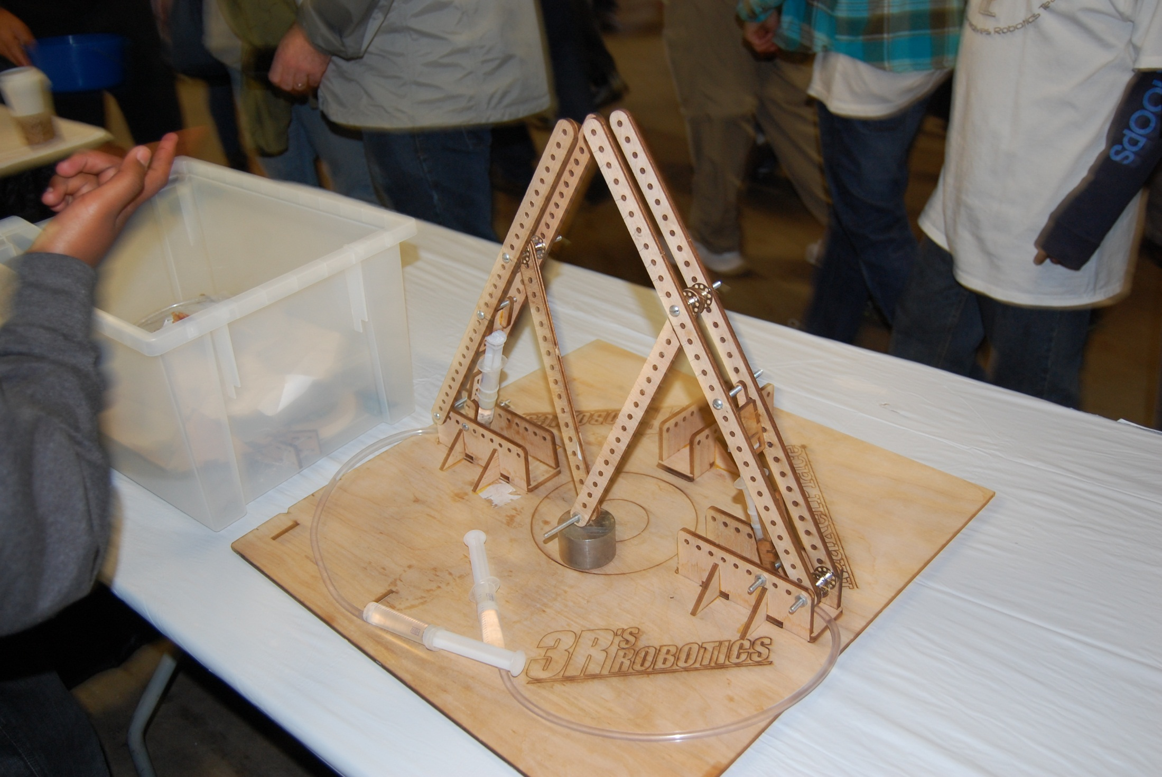
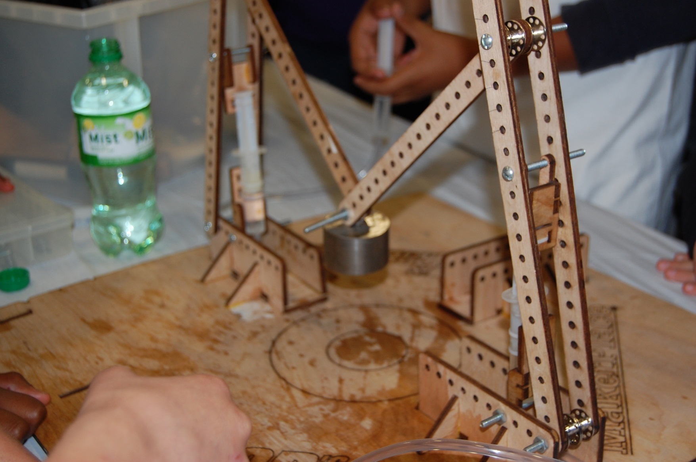
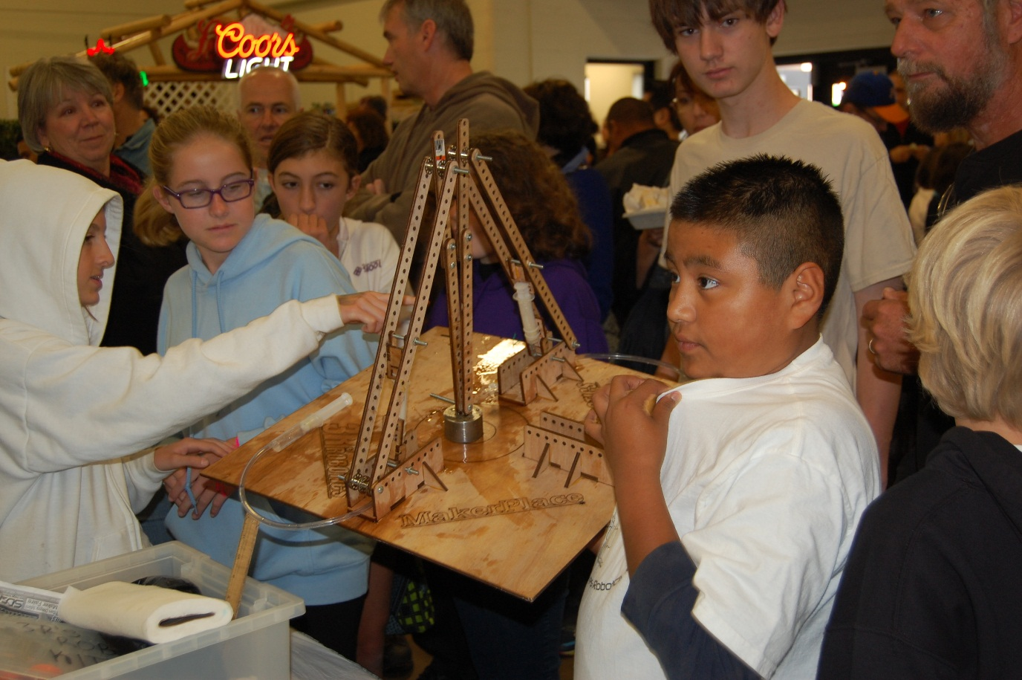

Slide 20
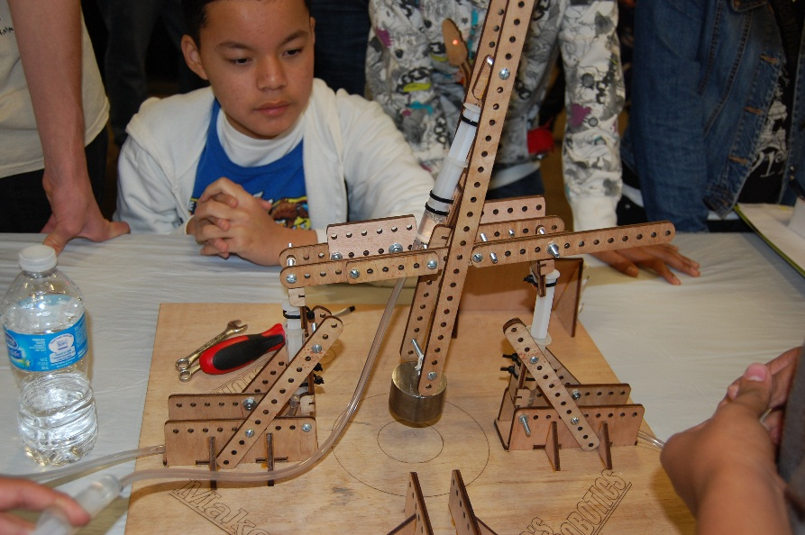
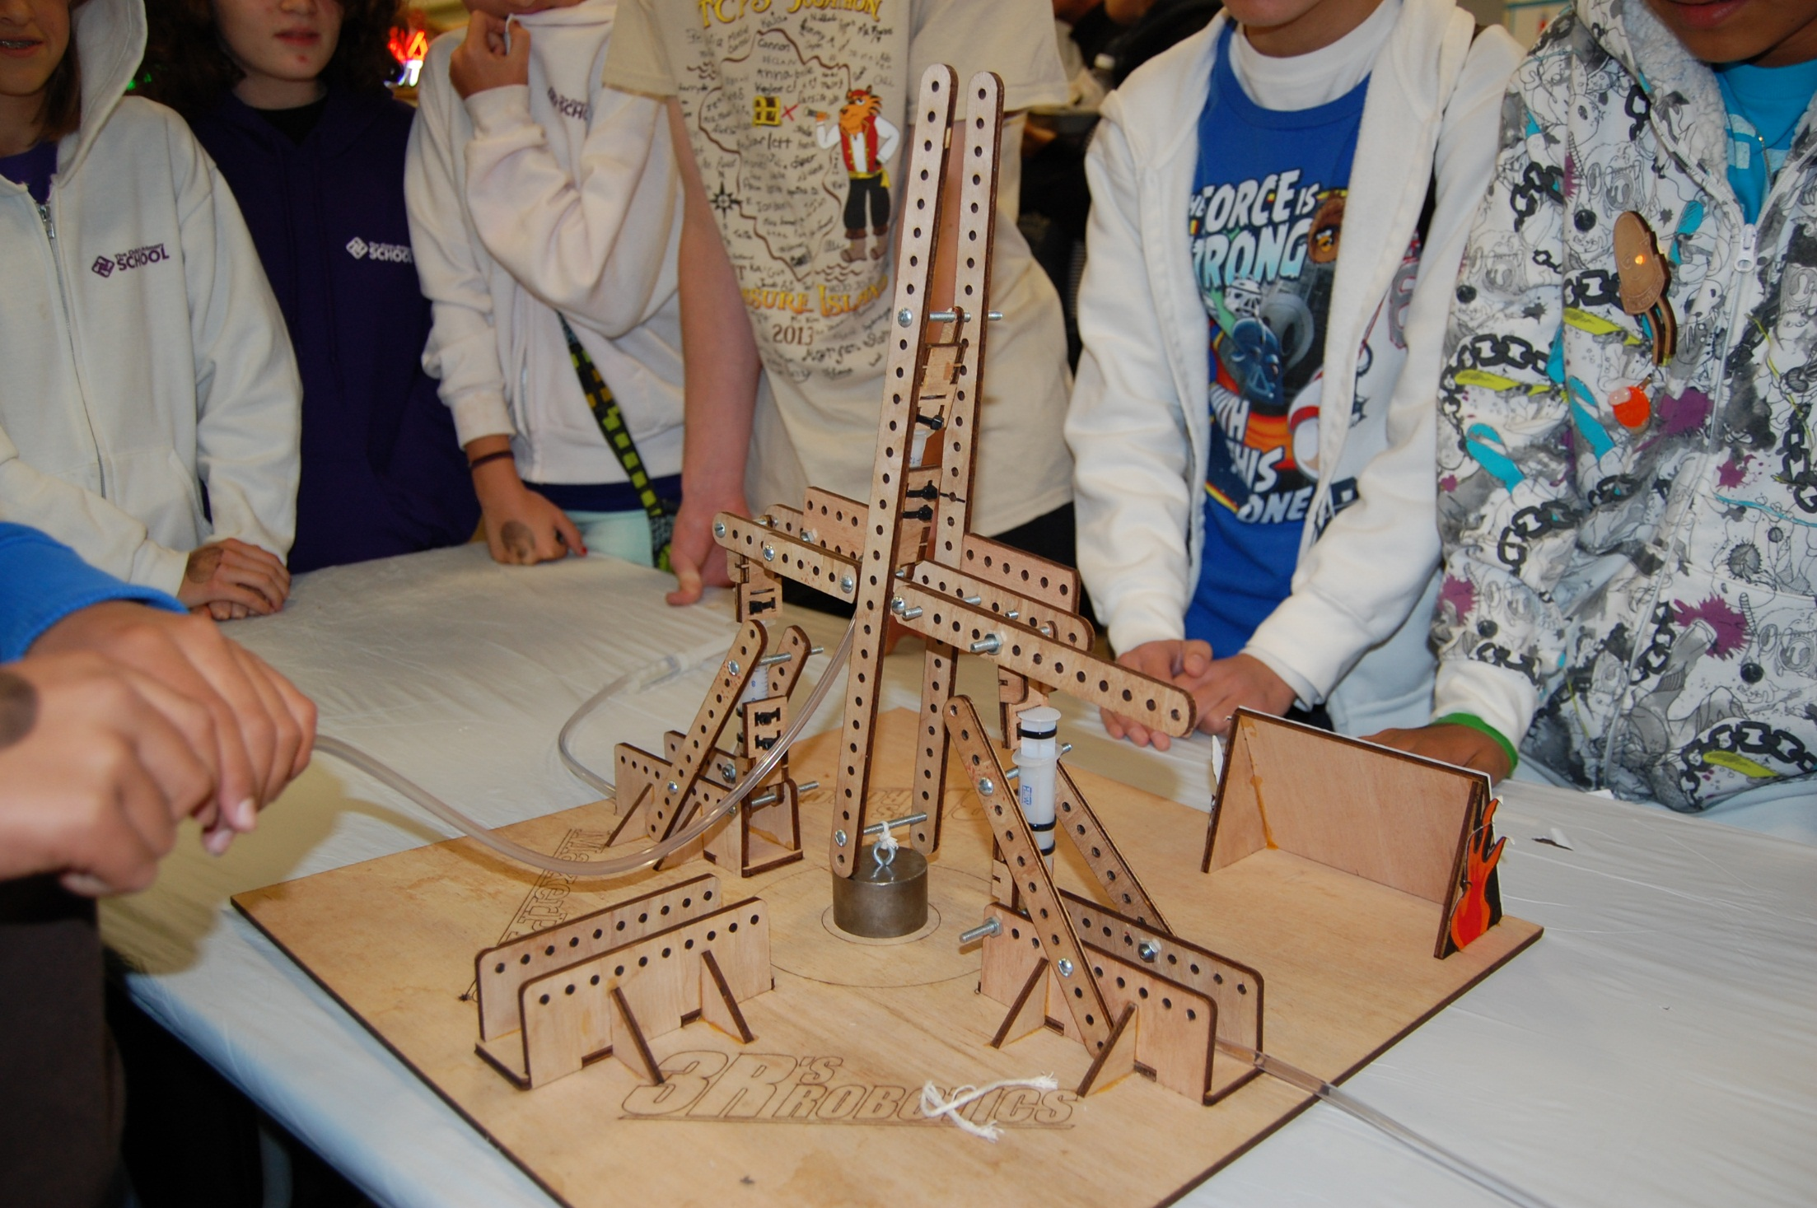
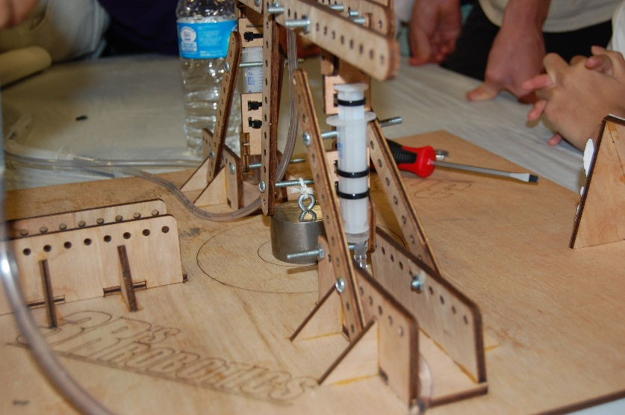
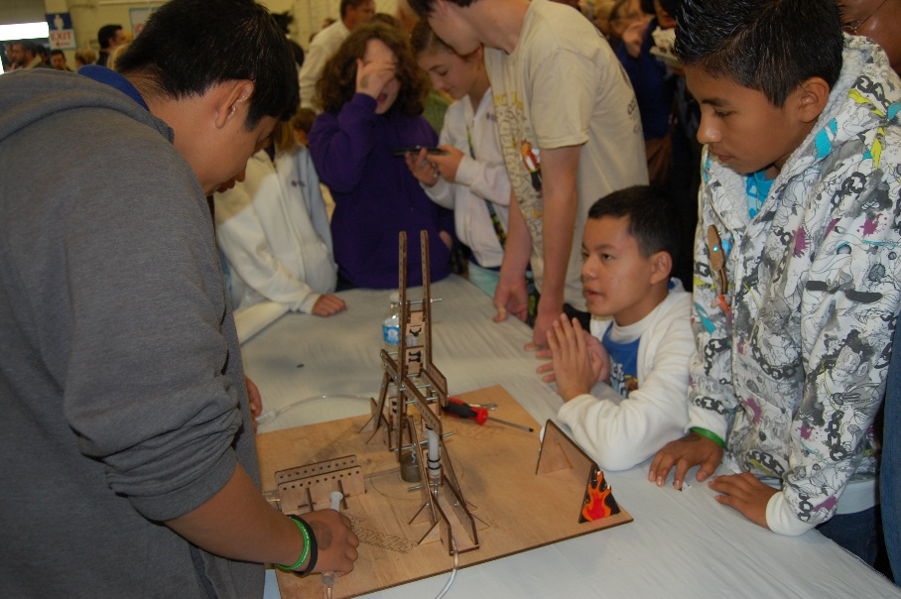

Slide 21
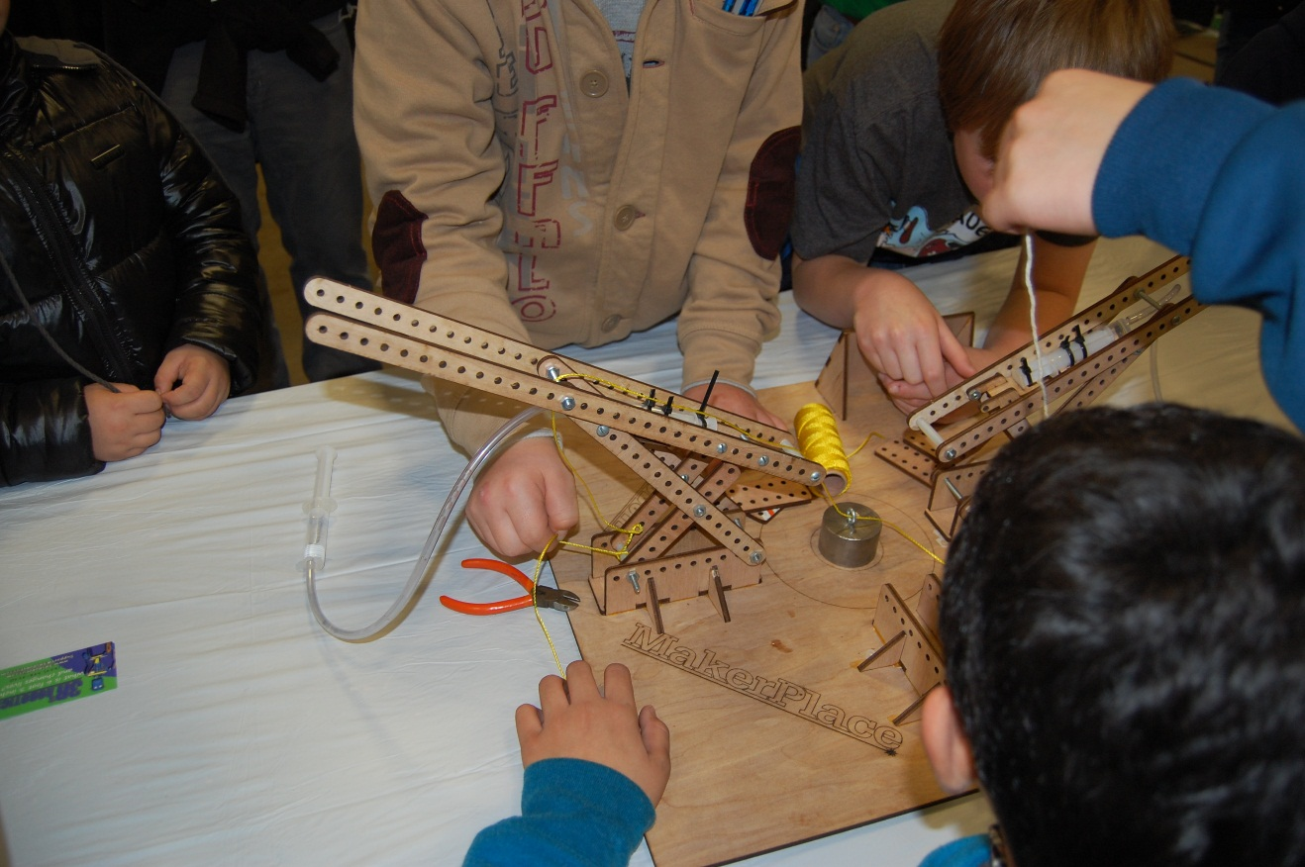
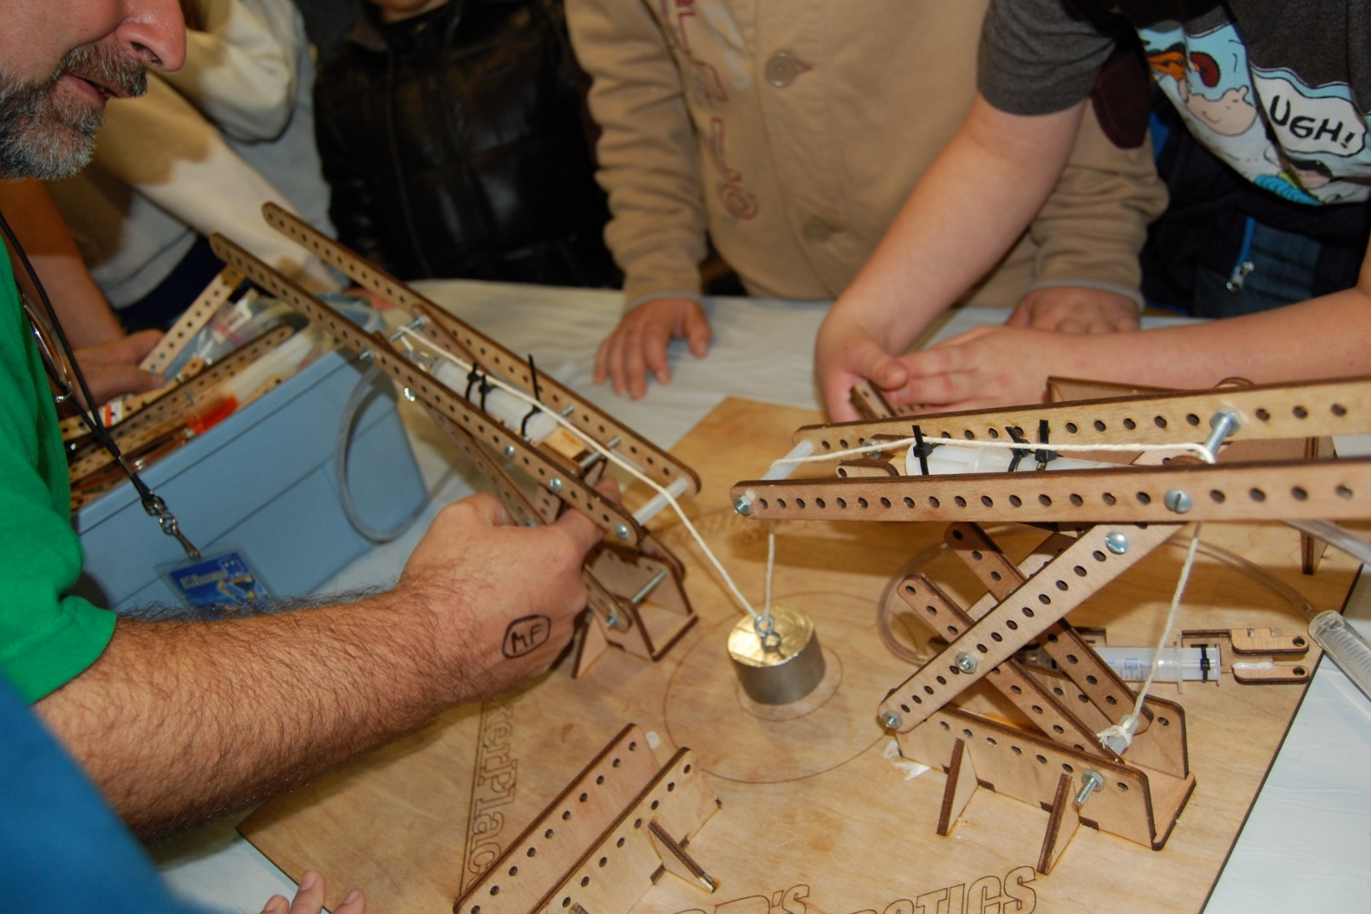
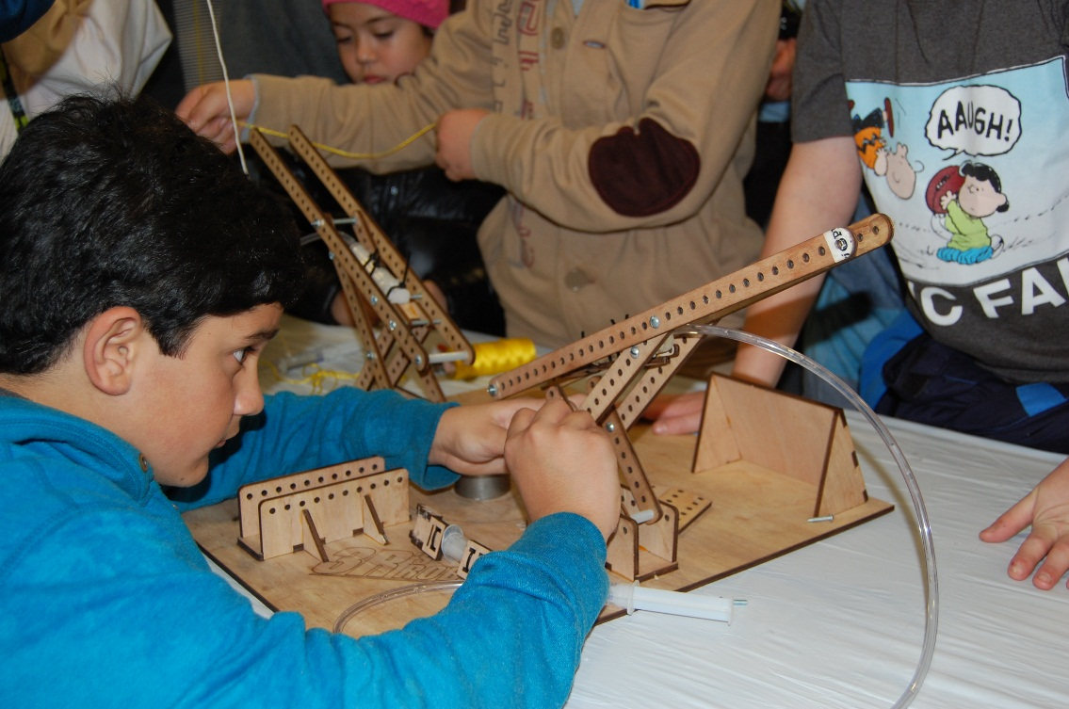

Slide 22

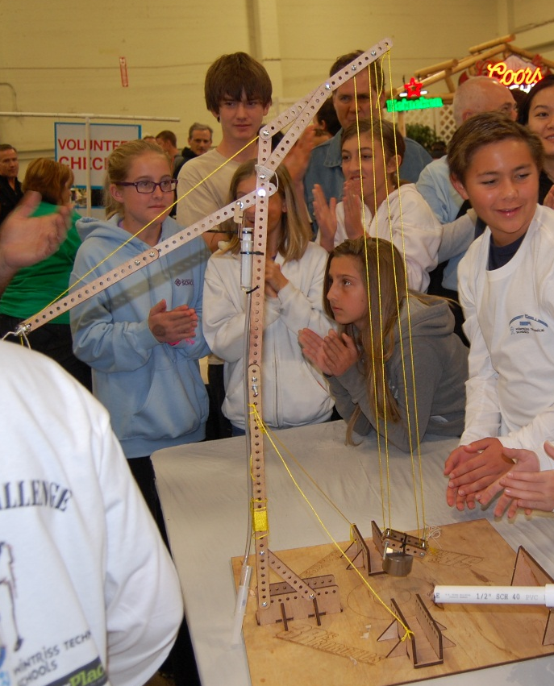
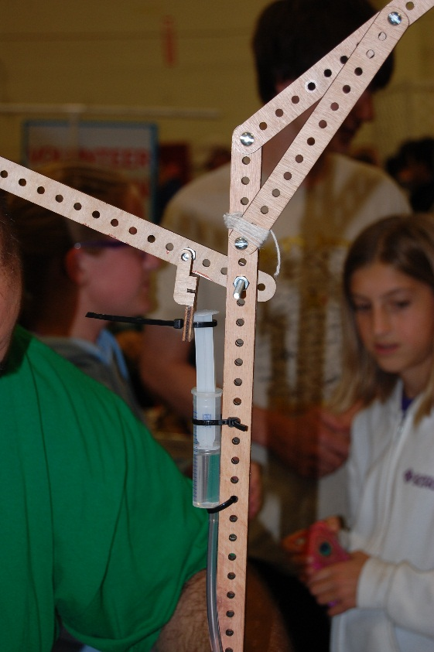
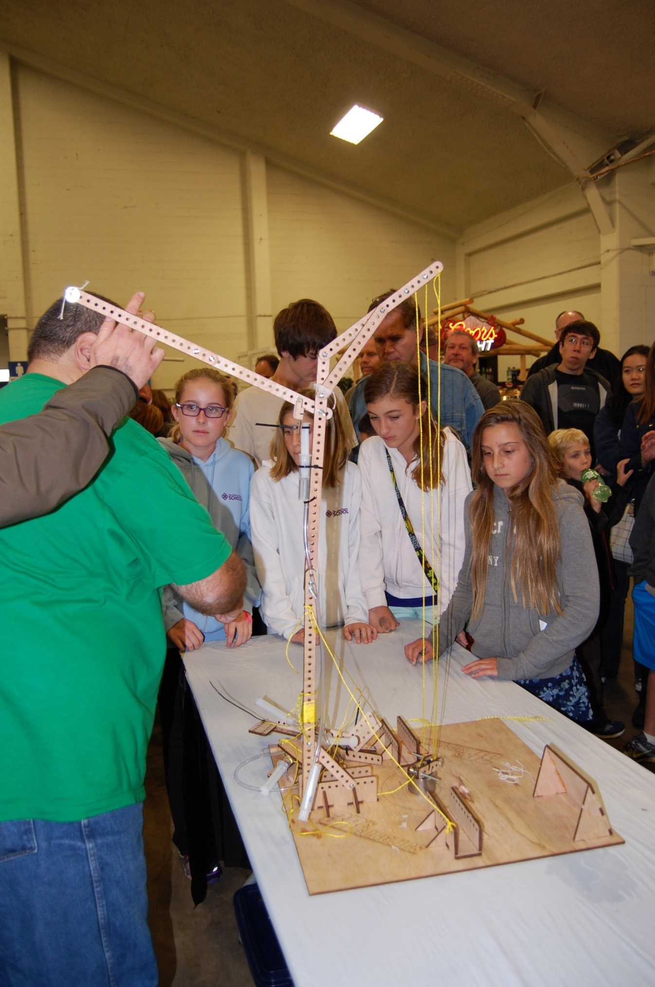

Slide 23

Success in any of the Hydro-Bot Challenges requires the creative use of String and Pulleys. They are the best tool we have for maximizing force and controlling the position of your load.
Notes:
It is important to remember that the success of any Super-Lift requires the creative use of String and Pulleys, as well as the incorporation of multiple simple machines in its overall design.

